Slide 1


Power BI Project: A Deep Dive into the Food and Beverage Industry
This presentation explores the use of Power BI to analyze critical aspects of the food and beverage industry. By leveraging data-driven insights, we can optimize operations, improve customer experiences, and drive profitability.
BY- Anshul Nimmala

Slide 2
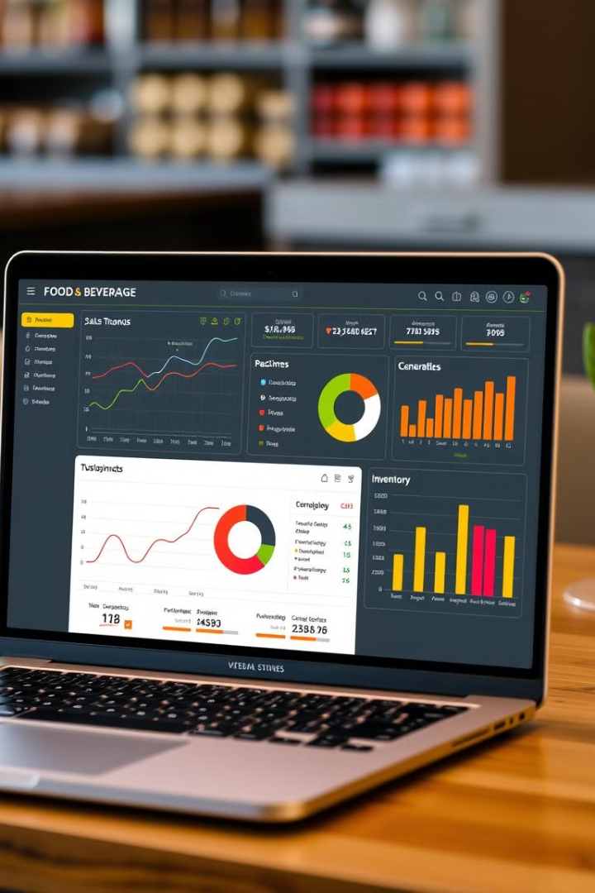
Data Sources and Preparation
1
Point-of-Sale (POS) Systems
2
Inventory Management Systems
POS systems capture real-time sales data, providing valuable insights into customer behavior, product popularity, and transaction trends.
Inventory systems track stock levels, order history, and supplier information, enabling efficient stock management and cost optimization.
3
Customer Relationship Management (CRM) Systems
4
Financial Data
Financial data, such as income statements and balance sheets, provides a comprehensive overview of the business's financial performance.
CRM systems store customer information, preferences, and interactions, facilitating targeted marketing campaigns and personalized service.

Slide 3
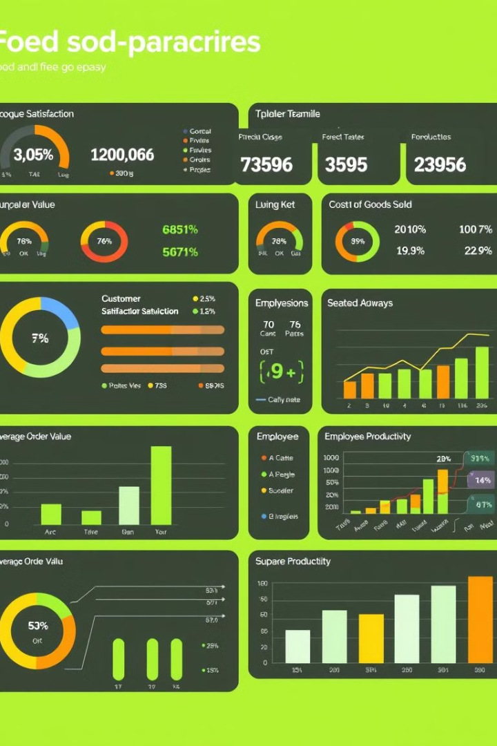
Key Performance Indicators (KPIs)
KPI
Description
Revenue
Total income generated from sales of food and beverages.
Customer Satisfaction
Measures customer happiness and loyalty through surveys or feedback forms.
Average Order Value
Average amount spent per customer order, indicating customer spending habits.
Cost of Goods Sold (COGS)
Direct expenses associated with producing and selling food and beverages.
Employee Productivity
Measures the efficiency of staff in serving customers and managing operations.

Slide 4
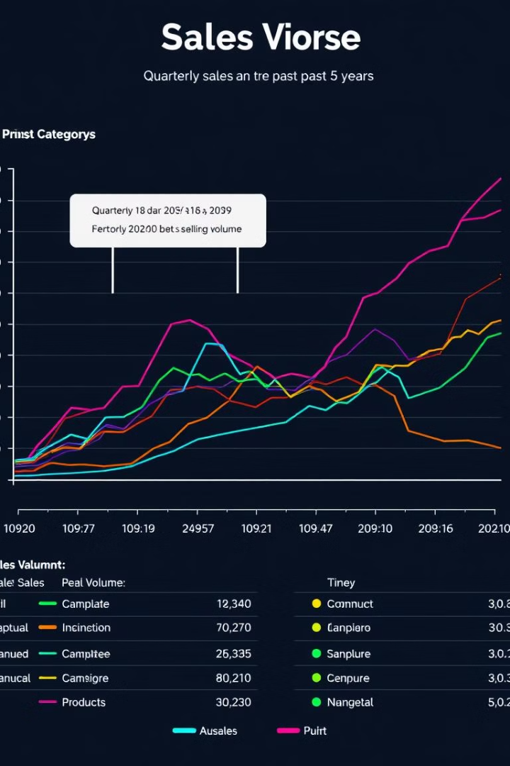

Sales Analysis
1
Product Performance
Identify best-selling items, analyze trends in demand, and optimize product offerings based on sales data.
2
Customer Behavior
Analyze customer purchase patterns, preferred payment methods, and loyalty programs to understand customer preferences and tailor marketing efforts.
3
Sales by Location
Compare sales performance across different locations, identify high-performing outlets, and understand regional variations in demand.
4
Seasonal Trends
Analyze sales data to identify seasonal fluctuations and plan promotions or adjust inventory accordingly.

Slide 5

Inventory Management
Inventory Levels
Cost Optimization
Waste Reduction
Track stock quantities, reorder points, and lead times to ensure sufficient inventory without excess stock.
Analyze purchase history, negotiate with suppliers, and optimize ordering quantities to minimize inventory costs.
Monitor inventory spoilage, implement stock rotation practices, and optimize storage conditions to reduce waste and improve efficiency.

Slide 6
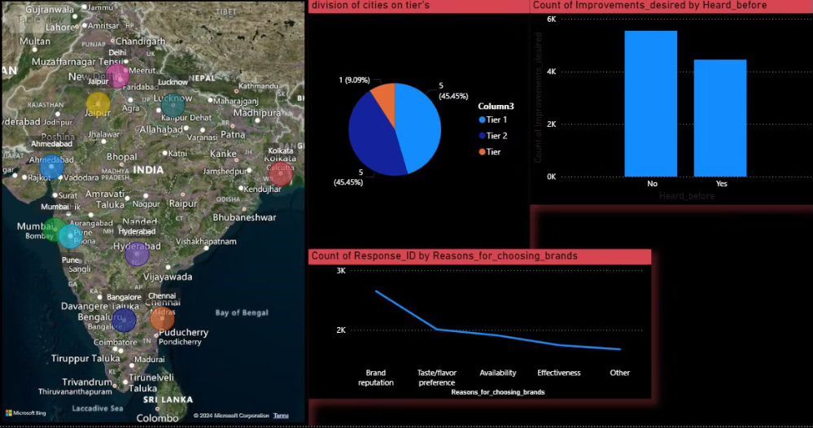

ANALYSIS AND INSIGHTS

Slide 7
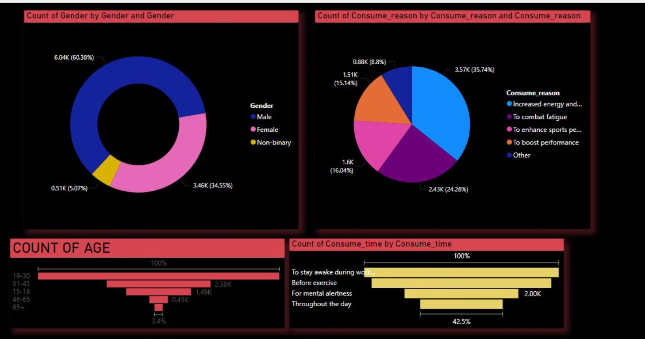

ANALYSIS AND INSIGHTS

Slide 8



ANALYSIS AND INSIGHTS

Slide 9

Customer Segmentation
Demographics
Spending Habits
Preferences
Segment customers based on age, gender, location, and other demographic characteristics to understand their needs and preferences.
Group customers based on spending frequency, average order value, and preferred products to tailor promotions and offers.
Identify customer preferences for specific cuisines, dietary restrictions, and dining experiences to personalize marketing messages and product recommendations.

Slide 10
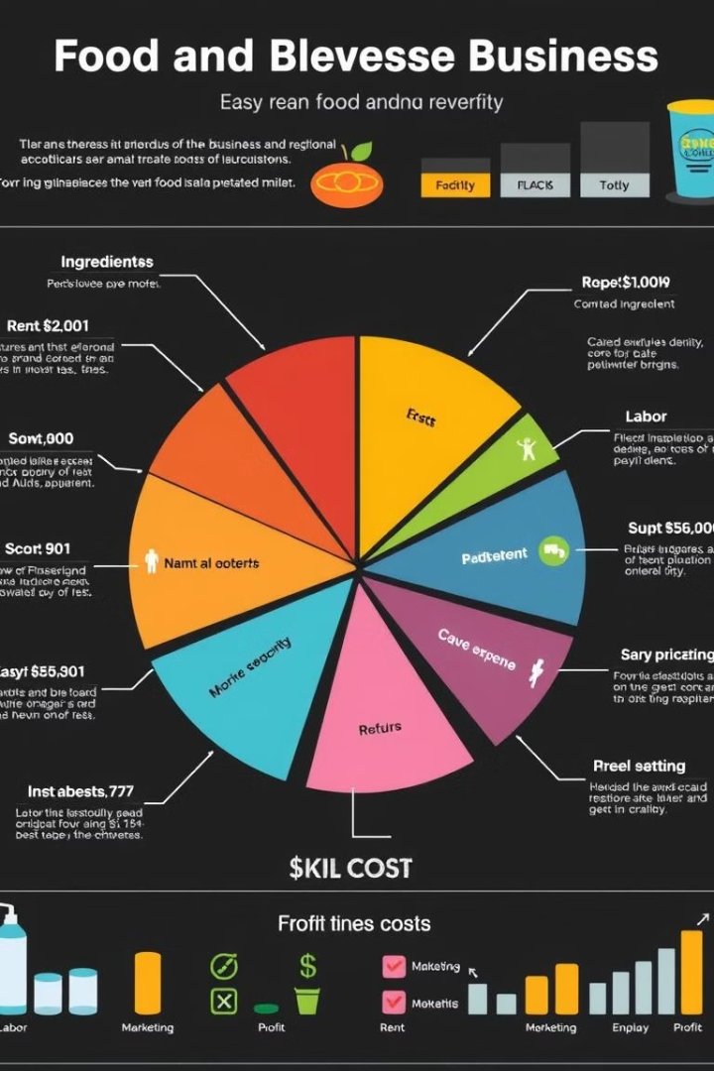



Profitability Insights
Cost Analysis
Analyze the cost of goods sold, labor costs, marketing expenses, and other operational costs to identify areas for cost reduction.
Pricing Strategies
Evaluate pricing models, consider competitor pricing, and analyze the impact of pricing changes on customer behavior and profitability.
Profit Margins
Calculate profit margins for different products and services to identify areas for improvement and prioritize profit-generating activities.

Slide 11
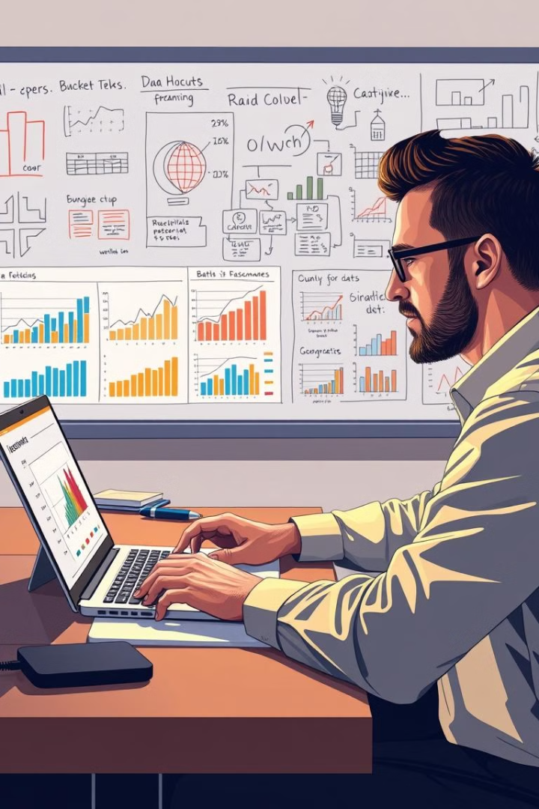

Conclusion and Recommendations
Data-Driven Decision Making
Utilizing data-driven insights empowers businesses to make informed decisions about pricing, product development, marketing campaigns, and operational improvements.
Enhanced Customer Experience
By understanding customer behavior and preferences, businesses can tailor their offerings and service to enhance customer satisfaction and loyalty.
Sustainable Growth
Through continuous analysis and optimization, businesses can achieve sustainable growth, improve profitability, and remain competitive in the dynamic food and beverage industry.

